Slide 1
Coordinated Epigenetic Control of Cortical Interneuron Lineage Specification in Health and Disease
Niko Eng
05/07/2020

Slide 2

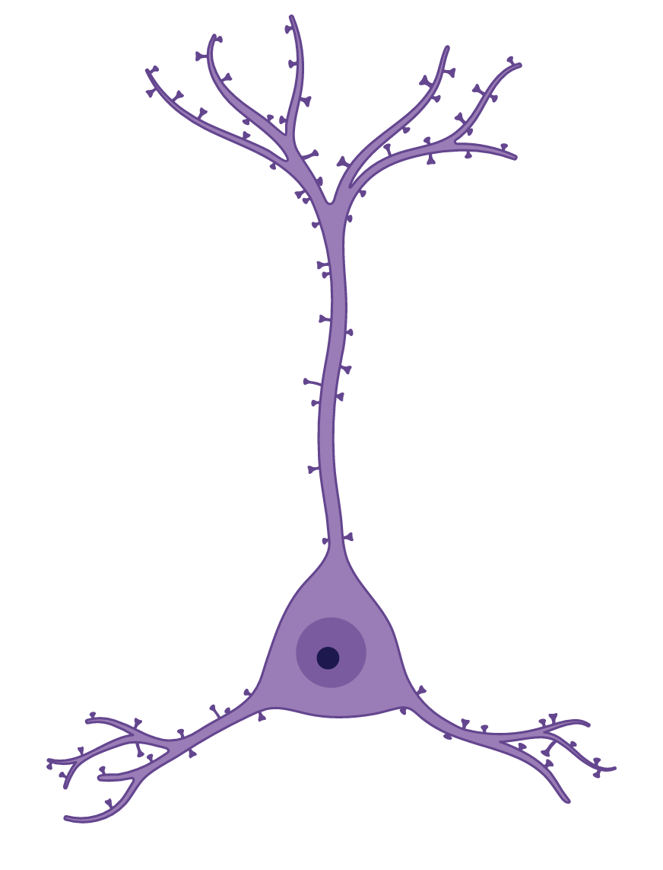
Two Types of Neurons in the Cortex
Excitatory Neurons
GABAergic Interneurons
Notes:
There are two types of neurons in the cortex, Excitatory Neurons shown and GABAergic Interneurons

Slide 3


Development of Excitatory Neurons Well Understood
Excitatory Neurons
GABAergic Interneurons
Notes:
While much focus has been on understanding the development of excitatory neurons and cortical expansion

Slide 4


Interneuron Development is Poorly Understood In Humans
?
Excitatory Neurons
GABAergic Interneurons
Notes:
Interneuron development is much less well understood in humans

Slide 5
Disrupted Interneuron Development Implicated in Disease
GABAergic Interneurons
Notes:
However, interneuron development disrupted in many poorly understood neuropsychiatric diseases

Slide 6
Disrupted Interneuron Development Implicated in Disease
Epilepsy – Dlx1&2 mutants disrupt interneuron migration
GABAergic Interneurons

Slide 7
Disrupted Interneuron Development Implicated in Disease
Epilepsy – Dlx1&2 mutants disrupt interneuron migration
Schizophrenia & Autism – GABAergic deficit affect cortical excitatory-inhibitory balance
GABAergic Interneurons

Slide 8
Neuropsychiatric Diseases are Highly Genetic
Anxiety
Alcoholism
Depression
Phobia
Conduct
ADHD
PTSD
Bipolar
Eating Disorder
OCD
ASD
Schizophrenia
Tourette
Flint and Geshwind et. al. 2015
Notes:
In particular

Slide 9
Neuropsychiatric Diseases are Highly Genetic
Anxiety
Alcoholism
Depression
Phobia
Conduct
ADHD
PTSD
Bipolar
Eating Disorder
OCD
ASD
Schizophrenia
Tourette
Gene
CRE
Cis-Regulatory Element
Gene
Gene Region
Only 5% SNPs in Coding Regions
Flint and Geshwind et. al. 2015

Slide 10
Most GWAS SNPs Lie in Non-Coding Regions of the Genome
TF
TF
Anxiety
Alcoholism
Depression
Phobia
Conduct
ADHD
PTSD
Bipolar
Eating Disorder
OCD
ASD
Schizophrenia
Tourette
CRE
Gene
CRE
CRE
Cis-Regulatory Element
Gene
Gene Region
Only 5% SNPs in Coding Regions
Flint and Geshwind et. al. 2015

Slide 11
GWAS SNPs are Enriched in Fetal Tissue
Distribution of SNPs in Accessible Chromatin
Adult only
Fetal origin
Fetal only
Large Clinical Implications for Understanding Epigenetic Mechanisms of Interneuron Development

Slide 12
Broad Objectives
CRE
Cis-Regulatory Elements
GWAS SNP
TF
TF
Transcription Factor
TF
CRE
Gene
CRE

Slide 13
Broad Objectives
CRE
Cis-Regulatory Elements
GWAS SNP
TF
1) Epigenetic regulation of interneuron development and fate
TF
Transcription Factor
TF
TF
TF
TF
TF
CRE
Gene
CRE

Slide 14
Broad Objectives
CRE
Cis-Regulatory Elements
GWAS SNP
TF
1) Epigenetic regulation of interneuron development and fate
TF
Transcription Factor
TF
TF
TF
TF
TF
CRE
Gene
CRE
Interneuron Development / Fate Specification

Slide 15
Broad Objectives
CRE
Cis-Regulatory Elements
GWAS SNP
TF
1) Epigenetic regulation of interneuron development and fate
TF
Transcription Factor
TF
TF
TF
TF
TF
CRE
Gene
CRE
Interneuron Development / Fate Specification

Slide 16
Broad Objectives
CRE
Cis-Regulatory Elements
GWAS SNP
TF
1) Epigenetic regulation of interneuron development and fate
TF
Transcription Factor
TF
CRE
Gene
CRE
Interneuron Development / Fate Specification

Slide 17
Broad Objectives
CRE
Cis-Regulatory Elements
GWAS SNP
TF
1) Epigenetic regulation of interneuron development and fate
TF
Transcription Factor
TF
CRE
Gene
CRE
Interneuron Development / Fate Specification

Slide 18
Broad Objectives
CRE
Cis-Regulatory Elements
GWAS SNP
TF
1) Epigenetic regulation of interneuron development and fate
TF
Transcription Factor
TF
CRE
Gene
CRE
Interneuron Development / Fate Specification

Slide 19
Broad Objectives
CRE
Cis-Regulatory Elements
GWAS SNP
TF
1) Epigenetic regulation of interneuron development and fate
2) How do cis-regulatory elements contribute to interneuron related diseases?
TF
Transcription Factor
TF
CRE
Gene
CRE
Interneuron Development / Fate Specification
Disease

Slide 20
Main Hypothesis
Key transcription factors coordinate to modulate proper fate specification and development, and the disruption of functional cis-regulatory elements due to disease-associated genetic variation could contribute to interneuron-related pathogenesis.

Slide 21
Main Hypothesis
Key transcription factors coordinate to modulate proper fate specification and development, and the disruption of functional cis-regulatory elements due to disease-associated genetic variation could contribute to interneuron-related pathogenesis.
What do we currently know?

Slide 22
Interneurons Develop in the Ganglionic Eminence in Both Mouse and Human
Cortex
LGE
Ganglionic Eminence
CGE
MGE
Developing Mouse Brain Schematic

Slide 23
Ganglionic Eminence Separated into Three Distinct Regions
Cortex
LGE
CGE
MGE

Slide 24
Ganglionic Eminence Separated into Three Distinct Regions
Cortex
Sp8
LGE
Coup-TFII
Sp8
CGE
MGE
Nkx2.1

Slide 25
Radial Glia Stem Cells are Neuronal Precursors
Cortex
Radial Glia
LGE
CGE
MGE

Slide 26
Developmental Program Across Regions
Cortex
Intermediate Progenitor
Radial Glia
LGE
CGE
MGE

Slide 27
Developmental Program Across Regions
Cortex
Intermediate Progenitor
Radial Glia
Neuroblast
LGE
CGE
MGE

Slide 28
GABAergic Interneurons Migrate Outwardly to Final Destinations
Cortex
REELIN+
VIP+
Intermediate Progenitor
Radial Glia
Neuroblast
PV+, SST+
LGE
CGE
MGE

Slide 29
GABAergic Interneurons Migrate Outwardly to Final Destinations
Cortex
Intermediate Progenitor
Radial Glia
Neuroblast
LGE
CGE
MGE
Olfactory Bulb

Slide 30
Both Regional and Common Transcriptional Necessary for Proper Development
Cortex
Intermediate Progenitor
Radial Glia
Neuroblast
Sp8
LGE
Coup-TFII
Sp8
CGE
Common Factors
MGE
Sox2
Ascl1
Nkx2.1
Dlx2
Olfactory Bulb

Slide 31
GABAergic Interneurons Arise From a Common Developmental Program
How do regional and common transcription factors coordinate to mediate development and specification?
Cortex
Sp8
Sp8
LGE
Coup-TFII
CGE
Common Factors
MGE
Sox2
Ascl1
Nkx2.1
Dlx2
Olfactory Bulb

Slide 32
Subtype Specification is Determined Spatially and Temporally
Cortex
LGE
CGE
MGE
Olfactory Bulb

Slide 33
Subtype Specification is Determined Spatially and Temporally
Cortex
LGE
CGE
PV+
MGE
Olfactory Bulb
SST+

Slide 34
Lineage Diversity is Regulated Spatially and Temporally
Cortex
LGE
CGE
MGE
E10
PV+ GP
Olfactory Bulb

Slide 35
Lineage Diversity is Regulated Spatially and Temporally
Cortex
LGE
SST+
CGE
MGE
E12
Olfactory Bulb

Slide 36
Lineage Diversity is Regulated Spatially and Temporally
Cortex
LGE
PV+
CGE
MGE
E14
Olfactory Bulb

Slide 37
Lineage Diversity is Regulated Spatially and Temporally
Much Unknown about cellular diversity in humans during late 2nd Trimester and 3rd Trimester (22GW onward)
Cortex
LGE
CGE
MGE
Olfactory Bulb

Slide 38


Mouse and Humans Have Divergent Interneuron Features
Features | Mouse | Human
Ganglionic Eminences Main Source
LGE, MGE, CGE Separate
Interneuron Abundance
Subtype Diversity
Proportions of Cortical Interneurons (MGE / CGE)
Dense Clusters in MGE outer Subventricular Zone
Extended MGE Neurogenesis Period until Birth
70 / 30
50 / 50
Need For Direct Human Studies

Slide 39
Current Unknowns
How do regional and common transcription factors coordinate to mediate development and specification?
Cellular diversity varies across development? Cis-regulatory elements contribute to disease?
Cortex
LGE
CGE
MGE
Olfactory Bulb

Slide 40
Current Unknowns
How do regional and common transcription factors coordinate to mediate development and specification?
Cortex
LGE
CGE
MGE
Olfactory Bulb

Slide 41
3D Epigenomic Characterization of Corticogenesis
RG – Radial Glia
IPC – Intermediate Progenitors
eN – Excitatory Neurons
iN - Interneurons
FACS

Slide 42
3D Epigenomic Characterization of Corticogenesis
RG – Radial Glia
IPC – Intermediate Progenitors
eN – Excitatory Neurons
iN - Interneurons
FACS
RNA-seq
ATAC-seq
H3K4me3 PLAC-seq

Slide 43
Interneurons Display Neuronal Transcriptome, but a Progenitor-Like Epigenome
RG – Radial Glia
IPC – Intermediate Progenitors
eN – Excitatory Neurons
iN - Interneurons
FACS
RNA-seq
ATAC-seq
H3K4me3 PLAC-seq
interneurons had mature transcriptome
interneurons have more immature epigenome

Slide 44
Sox2 Remains Expressed in Cortical Migrated Interneurons
RG – Radial Glia
IPC – Intermediate Progenitors
eN – Excitatory Neurons
iN - Interneurons
FACS
RNA-seq
ATAC-seq
H3K4me3 PLAC-seq
interneurons had mature transcriptome
interneurons have more immature epigenome

Slide 45
Identify Cell-Type Specific Cis-Regulatory Elements and Target Genes
RG
Gene A
Gene B
CRE
Gene C
CRE
IPC
Gene A
Gene B
Gene C
CRE
CRE
CTS RG IL
CRE
CTS IPC IL
CRE

Slide 46
Identify Cell-Type Specific Cis-Regulatory Elements and Target Genes
Gene A
Gene B
CRE
Gene C
CRE
IPC
Gene A
Gene B
Gene C
CRE
CRE
CTS RG IL
CRE
Gene Targets
Gene B
Gene C
CTS IPC IL
CRE
Gene Targets
Gene A
Gene C

Slide 47
Sox2 motifs are enriched at cell-type specific distal interacting loci
RG
Gene A
Gene B
CRE
Gene C
CRE
IPC
Gene A
Gene B
Gene C
CRE
CRE
CTS RG IL
CRE
Gene Targets
Gene B
Gene C
CTS IPC IL
CRE
Gene Targets
Gene A
Gene C

Slide 48
Sox2 putatively regulates both interneuron development and MGE fate specification

Slide 49
Sox2 putatively regulates both interneuron development and MGE fate specification
GABAergic Interneuron Development
CIN MGE Subtype Specification

Slide 50
Sox2 putatively regulates both interneuron development and MGE fate specification
GABAergic Interneuron Development
CIN MGE Subtype Specification
Could Sox2 be regulating cortical interneuron development and MGE subtype specification?

Slide 51
Sox2 putatively regulates both interneuron development and MGE fate specification
GABAergic Interneuron Development
CIN MGE Subtype Specification
Could Sox2 be regulating cortical interneuron development and MGE subtype specification? mediated through distinct co-factors?

Slide 52
Model:
Sox2 Mediates Distinct Maturation Processes Through Independent Co-Factor Binding
Sox2
Nkx2.1
MGE Specifying Genes (Lhx6)
MGE Fate Specification
MGE iPC + Neuron
Sox2
Ascl1?
Dlx5, Dlx6, GAD1
GABAergic interneuron development

Slide 53
Model:
Different Co-Factors for Different Lineages?
Sox2
Nkx2.1
MGE Specifying Genes (Lhx6)
MGE Fate Specification
MGE iPC + Neuron
Sox2
Ascl1?
Dlx5, Dlx6, GAD1
GABAergic interneuron development
Sox2
Sp8? Coup-TFII?
CGE Specifying Genes
CGE and LGE Fate Specification
LGE/CGE Lineage
Sox2
Ascl1?
Dlx5, Dlx6, GAD1
GABAergic interneuron development
Hypothesis: Sox2 regulates interneuron fate specification through coordinated activity with distinct lineage-specific co-factors

Slide 54
Model:
Different Co-Factors for Different Lineages?
Sox2
Nkx2.1
MGE Specifying Genes (Lhx6)
MGE Fate Specification
MGE iPC + Neuron
Sox2
Ascl1?
Dlx5, Dlx6, GAD1
GABAergic interneuron development
Sox2
Sp8? Coup-TFII?
CGE Specifying Genes
CGE and LGE Fate Specification
LGE/CGE Lineage
Sox2
Ascl1?
Dlx5, Dlx6, GAD1
GABAergic interneuron development
Hypothesis: Sox2 regulates interneuron fate specification through coordinated activity with distinct lineage-specific co-factors
Aim I: Characterize Sox2 lineage-specific activity across interneuron subtypes during development.

Slide 55
Aim I: Characterize Sox2 lineage-specific activity across interneuron subtypes during development.
Sort distinct interneuron and progenitor populations across GE lineages
B. Assess lineage-specific activities of Sox2 at gene promoters with CUT&RUN, RNA-seq
C. Determine lineage-specific activities of Sox2 enhancers with in-silico promoter-enhancer connections.
D. Determine Sox2 co-occupancy with lineage-specific transcription factors using CUT&RUN

Slide 56
Aim I: Characterize Sox2 lineage-specific activity across interneuron subtypes during development.
Sort distinct interneuron and progenitor populations across GE lineages

Slide 57
Aim I: Characterize Sox2 lineage-specific activity across interneuron subtypes during development.
Sort distinct interneurons, progenitors, and stem cell populations across GE lineages
B. Assess lineage-specific activities of Sox2 at gene promoters in-silico with CUT&TAG, RNA-seq
C. Determine dynamics and lineage-specific activities of Sox2 cis-regulatory elements with integrated snATAC-seq
D. Determine Sox2 co-occupancy with lineage-specific transcription factors using CUT&TAG
Plan to Profile: 28GW, 30GW
Would like 3-5 samples of
22 – 25GW
LGE
Cortical Plate
CGE
MGE
FANS
MGE, CGE, LGE interneurons and progenitors
MGE and CGE Migrated interneurons

Slide 58

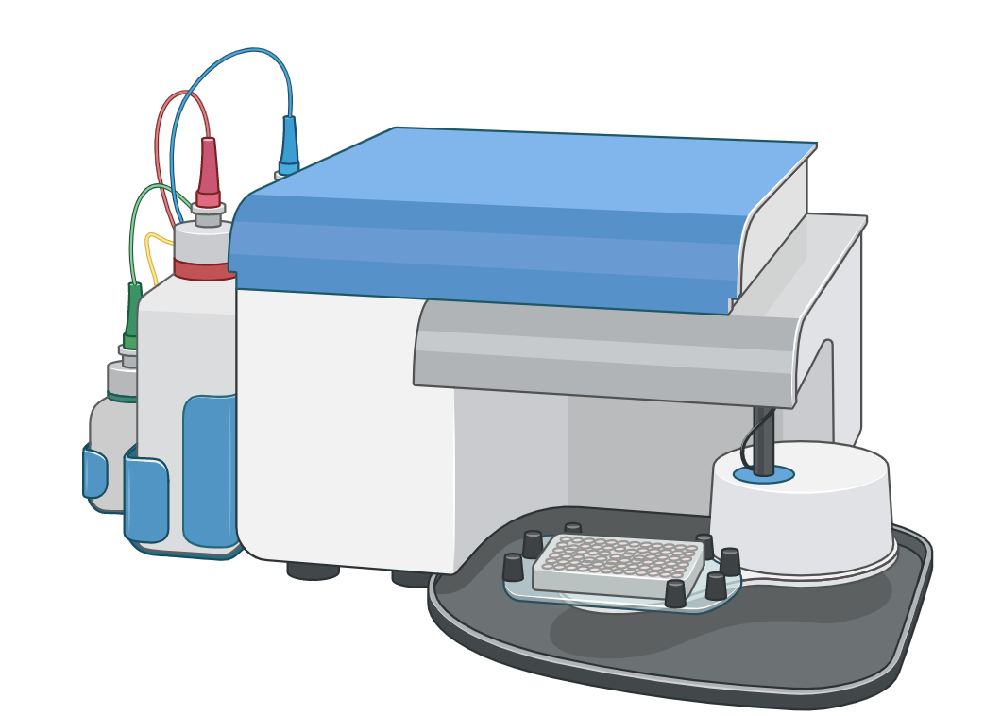
FACS Experimental Details for Ganglionic Eminence
LGE / MGE
Nkx2.1, Sox2, Ascl1, Sox6
LGE
CGE
MGE
Sox2
CGE
Sox2, Ascl1, Prox1, Sp8
Fixation, Staining
2nd and 3rd Trimester Ganglionic Eminence
Assess Markers with IHC
Nucleus Suspension
FANS

Slide 59
Sorting Schematic for Medial and Lateral Ganglionic Eminence
Marker Genes
Nkx2.1, Sox2, Ascl1, Sox6
MGE RG
MGE
iPCs
MGE INs
Nkx2.1+,Sox2^{hi}
Nkx2.1+, Sox2^{mid/lo}, Ascl1+
Nkx2.1+, Sox2^{mid/lo}, Ascl1-, Sox6+
Ascl1-
MGE
iPCs
MGE INs
LGE
RG
MGE RG
Sox2
Ascl1
LGE
RG
LGE
iPCs
Sox2
Nkx2.1-
Nkx2.1+
Ascl1
Sox6
Nkx2.1-, Sox2^{hi}
Nkx2.1-,
Sox2^{mid/lo},
Ascl1+
Nkx2.1
Keep Leftover
LGE
iPCs
Sox2
Ascl1

Slide 60
Sorting Schematic for Caudal Ganglionic Eminence
Marker Genes
Sox2, Ascl1, Prox1, Sp8
CGE
RG
CGE iPCs
CGE
IN-1
CGE
IN-2
Sox2^{hi},
Ascl1⁻
Sox2^{mid-lo},
Ascl1⁺
Sox2^{mid-lo},
Ascl1⁻,
Prox1+,
Sox2^{mid-lo},
Ascl1⁻,
Prox1-,
Sp8+
CGE iPCs
Ascl1
CGE
RG
Ascl1
CGE INs
Prox1
CGE INs
Sox2
Prox1
Sp8

Slide 61
FACS Experimental Details for Ganglionic Eminence
Cortical Plate
Dissect Cortical Plate
Sox2, Lhx6, Prox1
Fixation, Staining
2nd and 3rd Trimester Prefrontal Cortex Tissues
Marker Gene
Staining with Immunohistochemistry
Nucleus Suspension
FANS
Caveat alternative approach: NeuN, Prox1, Lhx6

Slide 62
Sorting Schematic for Prefrontal Cortex
Marker Genes
Lhx6, Sox2, Prox1
MGE CIN
MGE
mCIN
CGE CINs
MGE CIN
Lhx6+, Sox2+
Lhx6+, Sox2-
Lhx6+, Sox2+,
Prox1+
Lhx6-
Sox2
MGE
mCIN
Lhx6
CGE CINs
Lhx6
Prox1
Expected Results: I expect to Isolate 12 cell types of stem cells, progenitors, and interneurons from GE and PFC

Slide 63
Confirming Transcriptomic Identities
MGE RG
MGE
iPCs
MGE NBs
RNA-seq
Confirming Cell Identity
Expression of key marker genes
Compare to existing datasets (scRNA-seq cortex)
MGE mINs
MGE CIN
MGE
mCIN
CGE mINs/
LGE OB
CGE mINs
CGE CINs

Slide 64
Aim I: Characterize Sox2 lineage-specific activity across interneuron subtypes during development.
Sort distinct interneuron and progenitor populations across GE lineages
Major Results:
We will have developed a novel sorting strategy to capture stem cells, interneurons, and progenitors from different GE lineages.
We will have expanded our repertoire for sorting strategies in the prefrontal cortex to capture cortical migrated interneurons of distinct CGE and MGE lineage.

Slide 65
Aim I: Characterize Sox2 lineage-specific activity across interneuron subtypes during development.
Sort distinct interneuron and progenitor populations across GE lineages
B. Assess lineage-specific activities of Sox2 at gene promoters in-silico with CUT&RUN

Slide 66
Experiments
MGE RG
MGE
iPCs
MGE NBs
Sox2 CUT&RUN to Map binding
Map Chromatin States
H3K27ac, H3K4me3, H3K27me3, H3K4me1
(1-2 Replicates / Sample)
MGE mINs
MGE CIN
MGE
mCIN
(2 Biological Replicates / Sample)
CGE mINs/
LGE OB
CGE mINs
CGE CINs
Assess Sox2 Activity at promoters both
1) Across lineages
2) During development

Slide 67
Subaim Workflow
Sox2
2 Reps / Sample
Assess Sox2 Activity at promoters both
1) Across lineages
2) During development
CUT&RUN
Each Cell Population
+ RNA-seq
H3K27ac, H3K4me3, H3K27me3, H3K4me1
1-2 Reps / Sample

Slide 68
Comparing Across Lineages
Example: CGE IN vs. MGE IN
Cortex

Slide 69
Comparing Sox2 Activity at Promoters Across MGE IN vs. CGE IN
Characterize Gene Expression Differences with DESeq2
Identify shared and distinct Sox2 promoter peaks
Annotate Sox2 bound promoters with H3K4me3, H3K27ac, H3K27me3 data
HOMER motif analysis of shared and cell-type specific Sox2 promoters to identify putative co-factors
Integrate Annotated Sox2 Promoter Data with Gene Expression

Slide 70


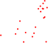
Aim IB
Characterize Gene Expression Differences with DESeq2
Sp8
COUP-TFII
GAD1
Dlx5
CGE IN RPKM
Lhx6
MGE IN RPKM
Sox6
Expected Results: I anticipate lineage specific genes to be differentially expressed.

Slide 71
Aim IB
Identify shared and cell-type specific Sox2 promoter peaks
% Of Sox2 Peaks
% Of Total Sox2 Promoter BS
Expected Results: I anticipate ~15-20% of Sox2 peaks to lie in promoter regions. I anticipate that most Sox2 promoters will be shared

Slide 72
Aim IB
Annotate promoters with H3K4me3, H3K27ac, H3K27me3 data
Expected Results: I anticipate most Sox2 promoters will have active marks, but some could have bivalent marks.

Slide 73
Aim IB
Integrate Annotated Sox2 Promoter Data with Gene Expression

Slide 74



Aim IB
Integrate Annotated Sox2 Promoter Data with Gene Expression
Bound in Both
Dlx5
H3K27ac
CGE IN
CGE Bound Only
MGE IN
Sp8
COUP-TFII
GAD1
MGE Bound Only
H3K4me3
CGE IN
Dlx5
MGE IN
CGE IN RPKM
Lhx6
CGE IN
H3K27me3
MGE IN
MGE IN RPKM
Sox6
CGE IN
Sox2
MGE IN
Expected Results: I anticipate that genes important for GABAergic development will be bound in both cell-types. I expect that lineage specific genes will be differentially bound by Sox2.

Slide 75
Aim IB
Integrate Annotated Sox2 Promoter Data with Gene Expression
Bound in Both
COUP-TFII
H3K27ac
CGE IN
CGE Bound Only
Sp8
MGE IN
COUP-TFII
GAD1
MGE Bound Only
H3K4me3
CGE IN
Dlx5
MGE IN
CGE IN RPKM
Lhx6
CGE IN
H3K27me3
MGE IN
MGE IN RPKM
Sox6
CGE IN
Sox2
MGE IN

Slide 76
Aim IB
Integrate Annotated Sox2 Promoter Data with Gene Expression
Bound in Both
Sox6
H3K27ac
CGE IN
CGE Bound Only
MGE IN
Sp8
COUP-TFII
GAD1
MGE Bound Only
H3K4me3
CGE IN
Dlx5
MGE IN
CGE IN RPKM
Lhx6
CGE IN
H3K27me3
MGE IN
MGE IN RPKM
Sox6
CGE IN
Sox2
MGE IN
Expected Results: At Sox2 differentially bound lineage specific genes, I anticipate chromatin marks reflecting activity restricted to that lineage, and repressive chromatin marks in the other lineage.

Slide 77




Aim IB
Integrate Annotated Sox2 Promoter Data with Gene Expression
Dlx2
Bound in Both
Coup-TFII
Sp8
CGE Bound Only
Sp8
COUP-TFII
Nkx2.1
GAD1
MGE Bound Only
Dlx5
CGE IN RPKM
Lhx6
HOMER Motif Analysis
MGE IN RPKM
Sox6
How could Sox2 activity at promoters drive interneuron development?
Expected Results: At differentially bound Sox2 promoters, I expect motif enrichment of lineage-specific co-factors. At shared Sox2 promoters, I expect motif enrichment for general GABAergic factors.

Slide 78
Aim IB
Dlx2
Bound in Both
Coup-TFII
Sp8
CGE Bound Only
Sp8
COUP-TFII
Nkx2.1
GAD1
MGE Bound Only
Dlx5
CGE IN RPKM
Lhx6
HOMER Motif Analysis
MGE IN RPKM
Sox6
Expected Results: At differentially bound Sox2 promoters, I expect motif enrichment of lineage-specific activators. At shared Sox2 promoters, I expect motif enrichment for general GABAergic factors.

Slide 79
Possible Model
Bound in Both
Less Mature
Mature
CGE Bound Only
MGE Bound Only
CGE IPC RPKM
CGE IN RPKM
MGE IPC RPKM
MGE IN RPKM
Sox2 promoter binding precedes gene activation

Slide 80
Aim IB
Bound in Both
Sox6
H3K27ac
CGE IN
CGE Bound Only
MGE IN
MGE Bound Only
Sox6
H3K4me3
CGE IN
CGE IPC RPKM
MGE IN
Capturing different developmental time points allows us to investigate
CGE IN
H3K27me3
MGE IN
MGE IPC RPKM
CGE IN
Sox2
MGE IN
How is Sox2 recruited?
Expected Results: Sox2 could be binding to bivalent promoters prior to activating lineage specific genes

Slide 81
Developmental Timing
Neurogenesis in Mouse
Cortex
Initiation
Peak Neurogenesis
MGE
LGE CGE
E9.5
E12.5
E12.5
E12.5
E15.5
E15.5
LGE
CGE
MGE

Slide 82
Aim IB
Integrate Sox2 Promoter Binding Data
Dlx2
Bound in Both
Coup-TFII
Sp8
CGE Bound Only
Sp8
COUP-TFII
Nkx2.1
GAD1
MGE Bound Only
Dlx5
CGE IN RPKM
Lhx6
HOMER Motif Analysis
MGE IN RPKM
Nkx2.1
Caveat: Sox2 could be acting in a repressive role
Expected Results: At differentially bound Sox2 promoters, I expect motif enrichment of lineage-specific activators. At shared Sox2 promoters, I expect motif enrichment for general GABAergic factors.

Slide 83

Aim IB
Integrate Sox2 Promoter Binding Data
REST
Dlx2
Bound in Both
Coup-TFII
Sp8
Sp8
COUP-TFII
Nkx2.1
GAD1
Dlx5
CGE IN RPKM
Lhx6
HOMER Motif Analysis
MGE IN RPKM
Nkx2.1
Expected Results: At differentially bound Sox2 promoters, I expect motif enrichment of lineage-specific activators. At shared Sox2 promoters, I expect motif enrichment for general GABAergic factors.

Slide 84
During Development
Cortex
Radial Glia
iPC
IN

Slide 85
Sox2 Primes Neurogenic Genes in Hippocampal NPCs
Neurogenic Genes
H3K27me3
Neural Progenitor Cells
H3K4me3
Neurogenesis
Sox2
Could Sox2 be binding to bivalent promoters of neurogenic / neuronal maturation genes during interneuron development?

Slide 86
Computational Workflow
RG vs. iPC
iPC vs. IN
Characterize Gene Expression Differences with DESeq2
Requirements for Sox2 Priming Activity:
1) Peak shared in both cell types
2) Gene differentially expressed
3) Bivalent to Active chromatin switch
Identify shared and distinct Sox2 promoter peaks
Annotate Sox2 bound promoters with H3K4me3, H3K27ac, H3K27me3 data
Integrate Annotated Sox2 Promoter Data with Gene Expression

Slide 87



Aim IB
Bound In Both
MGE RG Bound Only
MGE iPC Bound Only
MGE IN Bound Only
Nes
GAD67
Lhx6
Nkx2.1
MGE RG RPKM
MGE IN RPKM
Ascl1
MGE IPC RPKM
MGE IPC RPKM

Slide 88
Aim IB
Bound In Both
MGE RG Bound Only
MGE iPC Bound Only
MGE IN Bound Only
GAD67
GAD67
Caveat: Must follow up experimentally to confirm activities
RG
Lhx6
H3K4me3
IPC
IN
MGE IN RPKM
RG
H3K27me3
IPC
IN
RG
H3K27ac
IPC
MGE IPC RPKM
IN
RG
Expected Results: During interneuron development, Sox2 could be priming key developmental genes for further activation by binding to bivalent promoters.
Sox2
IPC
IN

Slide 89
Aim I: Characterize Sox2 lineage-specific activity across interneuron subtypes during development.
Sort distinct cortical interneuron and progenitor populations across GE lineages
B. Assess lineage-specific activities of Sox2 at gene promoters in-silico with CUT&RUN, RNA-seq
Major Results:
Across lineages, Sox2 regulates lineage specific genes through cell-type specific promoter binding. These promoters could have enrichment for lineage specific co-factors.
During interneuron development, Sox2 could be priming key developmental genes by binding to bivalent promoters for later activation.

Slide 90
Aim I: Characterize Sox2 lineage-specific activity across interneuron subtypes during development.
Sort distinct cortical interneuron and progenitor populations across GE lineages
B. Assess lineage-specific activities of Sox2 at gene promoters in-silico with CUT&RUN, RNA-seq
C. Determine lineage-specific activities of Sox2 cis-regulatory elements with integrated snATAC-seq
Note: Generating Ganglionic Eminence snATAC-seq for both Aim I and Aim II

Slide 91

Experimental Details snATAC-seq
LGE
DAPI
CGE
DAPI
MGE
Nkx2.1
Late 2nd and 3rd Trimester Ganglionic Eminence
Staining and Dissection of GE
Nucleus Suspension
10X Genomics scATAC-seq
15,000-20,000 cells per sample

Slide 92










Aim IC
Identifying Cell Cluster “In-Silico”
Prefrontal Cortex
Ganglionic Eminence
ATAC-seq Signal
Gene
Clustering with snapATAC
“Gene Activity Scores”
Data
Pre-Processing
UMAP-2
UMAP-2
MGE RG
MGE
iPCs
MGE NBs
MGE mINs
CGE mINs
CGE mINs/
LGE OB
MGE CIN
MGE
mCIN
CGE CINs
UMAP-1
UMAP-1
Alternative: Generate snRNA-seq to replace “gene activity scores”

Slide 93
Aim IC
Linking Cis-Regulatory Elements to Genes
Peak Calling and Annotation
MGE RG
MGE
iPCs
MGE mINs
UMAP-2
…
…
CGE mINs
Gene
UMAP-1
+/-500kb
MGE RG
Correlate Signal of Distal Peak to Gene Promoter over all clusters
MGE
iPCs
MGE NBs
MGE mINs
CGE mINs
CGE mINs/
LGE OB
MGE CIN
MGE
mCIN
CGE CINs
Alternative: Borrow TAD data from other brain tissues to define enhancer-promoter boundaries

Slide 94
Aim IC
Linking Sox2 Distal Elements to Genes
Peak Calling and Annotation
MGE RG
MGE
iPCs
MGE mINs
UMAP-2
…
…
CGE mINs
Gene
Links
UMAP-1
MGE RG
MGE
iPCs
MGE NBs
MGE mINs
CGE mINs
CGE mINs/
LGE OB
Caveat: Not cell-type specific or robust, but given H3K27ac and H3K4me3 data could identify high-confidence links
MGE CIN
MGE
mCIN
CGE CINs

Slide 95
Aim IC
Generating Robust Cell-Type Specific Links
Cell Type A
Requirements:
Gene Promoter has:
H3K4me3 peak
H3K27ac
H3K4me3
Cis-regulatory element has:
H3K27ac peak
H3k4me1
H3K27me3
Gene
Co-Accessible Links
Caveat: This approaches biases towards strong interactions
Robust Cell-Type Specific Link

Slide 96
Comparing Sox2 Enhancer Activity across Lineages
CGE IN vs. MGE IN
Cortex
How are distinct and cell-type specific Sox2 enhancers regulating gene expression?

Slide 97
Computational Workflow
Annotate Sox2 enhancers with H3K27ac and H3K4me1
Determine cell-type specific and shared Sox2 enhancers
Link Sox2 distal elements to genes
Integrate Differential Expression data with annotated Sox2 enhancers
Compare cell-type specific and shared motif enrichment with HOMER

Slide 98
Aim IC
Annotate Sox2 distal elements with H3K27ac and H3K4me1
Expected Results: I expect the majority of Sox2 distal enhancers to have marks of active or poised enhancers.

Slide 99
Aim IC
Determine cell-type specific and shared Sox2 enhancers
% Of Total Sox2 Distal Enhancers
Expected Results: Across lineages, I expect most Sox2 binding sites to be cell-type specific.

Slide 100
Aim IC
Link Sox2 distal elements to genes
MGE IN
Sox2 Distal Peaks
CGE IN
MGE IN
Links
CGE IN
Gene A
Gene B
Expected Results: Across lineages, I expect that shared Sox2 enhancers will be linked to the same genes that are important for GABAergic development.

Slide 101



Aim IC
Integrate Differential Expression data with annotated Sox2 enhancers
Sox2 Enhancers
Dlx5
Both Cell Types
CGE IN
H3K27ac
CGE IN only
MGE IN
MGE IN only
CGE IN
H3K4me1
MGE IN
Dlx5
CGE IN
CGE IN RPKM
H3K4me3
MGE IN
CGE IN
Sox2
MGE IN
MGE IN RPKM
Links
Expected Results: I expect that GABAergic development genes will be linked to Sox2 enhancers in both cell types.

Slide 102
Aim IC
Integrate Differential Expression data with annotated Sox2 enhancers
Linked in Both
Lhx6
CGE IN Distal Link Only
CGE IN
MGE IN Distal Link Only
H3K27ac
MGE IN
CGE IN
H3K4me1
Dlx5
MGE IN
CGE IN RPKM
CGE IN
Lhx6
H3K4me3
MGE IN
CGE IN
Sox2
MGE IN RPKM
MGE IN
Links
Expected Results: I anticipate that lineage specific genes will be linked to Sox2 enhancers of only that restricted lineage.

Slide 103
Aim IC
Compare cell-type specific and shared motif enrichment with HOMER
Shared Sox2 Enhancers: CTCF , Dlx1, Dlx2, Dlx5, Gsx2
MGE IN Sox2 Cell Type Specific Enhancers: CTCF, Sox6, Lhx6, Sox11, Nkx2.1
CGE IN Sox2 Cell Type Specific Enhancers: CTCF, Prox1,Sp8, Coup-TFI, Coup-TFII
How does Sox2 regulate enhancers during interneuron development?
Expected Results: I anticipate motif analysis of shared Sox2 enhancers will reveal transcription involved in general GABAergic development. I anticipate motif analysis of cell-type specific Sox2 enhancers will reveal enrichment of lineage-specific co-factors.

Slide 104
Evaluating Sox2 Enhancer Priming
Cortex
Radial Glia
iPC
IN

Slide 105
Computational Workflow
RG vs. iPC
iPC vs. IN
RG vs. iPC vs. IN
Annotate Sox2 distal elements with chromatin data
Determine cell-type specific and shared distal Sox2 elements
Link Sox2 distal elements to genes
Integrate Differential Expression data with annotated Sox2 enhancers
Future Directions:
1) How does Sox2 binding correspond with changes in chromatin state and accessibility? (Primed vs. Active Enhancers)
2) What enhancers are lost vs. gained and what genes do they putatively regulate?
3) Sox2-Sox2 promoter-enhancer links?

Slide 106


Aim IC
Bound In Both
MGE RG Distal Only
MGE iPC Distal Only
MGE IN Distal Only
Sox6
GAD67
Nes
Shh
Lhx6
Nkx2.1
MGE RG RPKM
MGE IN RPKM
Ki67
Ascl1
MGE IPC RPKM
MGE IPC RPKM

Slide 107
Aim IC
Bound In Both
MGE RG Bound Only
MGE iPC Bound Only
MGE IN Bound Only
Lhx6
Caveat: Would need functional data to confirm pioneering function
RG
Sox6
GAD67
H3K4me3
IPC
Lhx6
IN
RG
H3K4me1
MGE IN RPKM
Ki67
IPC
IN
RG
H3K27ac
IPC
IN
MGE IPC RPKM
RG
Sox2
IPC
IN

Slide 108
Aim IC
Robust Cell-Type Cis-Regulatory Element to Promoter Links
Lhx6
RG
MGE RG
H3K4me3
IPC
Sox2 Distal Peaks
IN
MGE IPC
RG
MGE IN
H3K4me1
IPC
IN
RG
H3K27ac
IPC
IN
RG
Sox2
IPC
IN

Slide 109
Aim I: Characterize Sox2 lineage-specific activity across interneuron subtypes during development.
Sort distinct cortical interneuron and progenitor populations across GE lineages
B. Assess lineage-specific activities of Sox2 at gene promoters in-silico with CUT&RUN, RNA-seq
C. Determine lineage-specific activities of Sox2 cis-regulatory elements with integrated snATAC-seq
Major Results:
Across lineages, cell-type specific Sox2 enhancers regulate lineage specific genes through interaction with lineage specific co-factors. These Sox2 enhancers are enriched for active enhancer marks.
During development, Sox2 will be exhibit cell-type specific activity regulating stem cell renewal genes, neuronal migratio

Slide 110
Aim I: Characterize Sox2 lineage-specific activity across interneuron subtypes during development.
Sort distinct cortical interneuron and progenitor populations across GE lineages
B. Assess lineage-specific activities of Sox2 at gene promoters in-silico with CUT&RUN, RNA-seq
C. Determine lineage-specific activities of Sox2 cis-regulatory elements
D. Assess Sox2 coordination with lineage-specific transcription factors using CUT&RUN and co-immunoprecipitation.

Slide 111
Workflow
Nkx2.1, CoupTFII
CUT&RUN
Assess Binding Overlap with Sox2
Assess Timing of binding by comparing with Sox2 across development
Candidate Transcriptions Factors: Motif Analysis + RNA-seq
Co-immunoprecipitation using regionally dissected MGE and CGE tissues
Expected Results: I expect Sox2 peaks to overlap Nkx2.1 peaks in MGE IN. I expect Sox2 peaks to overlap with Coup-TFII peaks in CGE IN.

Slide 112
Aim ID
Assess Binding Overlap with Sox2
% Total Sox2 Bound Sites
Expected Results: I expect Sox2 peaks to overlap Nkx2.1 peaks in MGE lineage cell-types. I expect Sox2 peaks to overlap with Coup-TFII peaks in CGE lineage cell-types.

Slide 113
Aim ID
Assess Timing of binding by comparing with Sox2 across development
RG
Nkx2.1
IPC
IN
RG
Sox2
IPC
IN
Expected Results: I anticipate that lineage-specific transcription factors and Sox2 will have overlapping binding in the same cell-type.

Slide 114
Aim ID
Assess Timing of binding by comparing with Sox2 across development
RG
Coup-TFII
IPC
IN
RG
Sox2
IPC
IN
Expected Results: I anticipate that there will be a higher proportion of overlapping binding in less mature cell-types.

Slide 115
Aim ID
RG
Nkx2.1
IPC
IN
MGE RG
MGE
iPCs
MGE NBs
Nkx2.1, CoupTFII
CUT&RUN
RG
MGE mINs
CGE mINs
CGE mINs/
LGE OB
Sox2
IPC
IN
MGE CIN
MGE
mCIN
CGE CINs
Differential Expression Analysis At Promoters and Enhancers in each lineage
Co-immunoprecipitation using regionally dissected GE tissues
Expected Results: I expect Sox2 peaks to overlap Nkx2.1 peaks in MGE IN. I expect Sox2 peaks to overlap with Coup-TFII peaks in CGE IN.

Slide 116
Aim ID
Integrate Peak Data
Shared Sox2 Peaks
CGE IN Sox2 & Coup-TFII
Overlap Peaks
MGE IN Sox2 & Nkx2.1 Overlap Peaks
GAD1
Dlx5
CGE IN RPKM
MGE IN RPKM
What about direct protein interaction?
Expected Results: I expect Sox2 and Coup-TFII overlapped peaks to be linked to CGE IN “lineage specific” genes. I expect Sox2 and Nkx2.1 overlap peaks to be linked to MGE IN “lineage specific genes”

Slide 117
Aim ID
Integrate Peak Data
Shared Sox2 Peaks
CGE IN Sox2 & Coup-TFII
Overlap Peaks
MGE IN Sox2 & Nkx2.1 Overlap Peaks
GAD1
Dlx5
CGE IN RPKM
MGE IN RPKM
What about direct protein interaction?
Expected Results: I expect Sox2 and Coup-TFII overlapped peaks to be linked to CGE IN “lineage specific” genes. I expect Sox2 and Nkx2.1 overlap peaks to be linked to MGE IN “lineage specific genes”

Slide 118
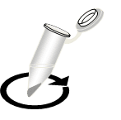
Aim ID
From Aim I
LGE
Coup-TFII
MGE
Nkx2.1
2nd and 3rd Trimester Ganglionic Eminence
Regional Dissection of MGE and CGE
Extract Lysates
CO-IP
I expect Sox2 and Nkx2.1 to co-bind indicating

Slide 119
Aim ID
From Aim I
MGE Lysate
CGE Lysate
IP:
IgG
Sox2
IP:
IgG
Sox2
Input
-
+
-
+
DNase
Input
-
+
-
+
DNase
Sox2
Sox2
Nkx2.1
Nkx2.1
Expected Results: I expect that Nkx2.1 will bind with Sox2 indicated as co-immunoprecipitated from Sox2 IP in MGE lysate. I expect that COUP-TFII will bind with Sox2 in CGE cells indicated as co-immunoprecipitation from Sox2 IP in CGE lysate. If Sox2 and Nkx2.1 bind separately from DNA, I expect a band in Nkx2.1 immunoblot with and without DNase treatment.

Slide 120
Summary Aim I
Developed strategy to isolate MGE, CGE, LGE populations across subtypes
Assessed lineage specific activity of Sox2 at promoters and distal elements
Identified putative lineage specific co-factors in-silico
Assessed co-localized DNA binding of Sox2 and lineage-specific genes
Showed direct protein-protein interaction with co-immunoprecipitation
Caveat: Future work will need to assess Sox2 function and binding order with lineage-specific transcription factors

Slide 121
Future Directions for Aim I
Sox2-EGFP-AID
MGE interneuron in-vitro differentiation system
Rapid Sox2 degradation at different developmental stages
Endogenous Sox2 Locus
Sox2
AID
eGFP
Sox2
AID
eGFP
RNA-seq WT vs. Sox2 degradation
AAVS1 safe harbor locus
OsTir1
Nkx2.1 CUT&RUN
Binds independently
No binding (dependent on Sox2)
CRISPR deletion of Nkx2.1 binding sites and Sox2

Slide 122
Nkx2.1 Binding
Aim ID
Sox2 Binding
Accessibility
4
5
4
5
3
3
Signal
Signal
2
2
1
Pseudotime
1
Pseudotime
3
4
5
Signal
2
1
Pseudotime

Slide 123
Aim ID
Electrophoretic Mobility Shift Assay to Determine Co-Occupancy
Nkx2.1 depends on Sox2 binding
Scrambled DNA
+
-
-
-
-
MGE IN Sequence
-
+
+
+
+
Recombinant Sox2
-
-
+
-
+
Recombinant Nkx2.1
-
-
-
+
+
Expected Results: I expect that Sox2 and Nkx2.1 will co-occupy MGE IN sequences that target lineage specific genes.

Slide 124
Aim ID
Electrophoretic Mobility Shift Assay to Determine Co-Occupancy
Nkx2.1 depends on Sox2 binding
MGE IN Sequence
+
+
+
Nuclear Extract
Expected Results: I expect that Sox2 and Nkx2.1 will co-occupy MGE IN sequences that target lineage specific genes.

Slide 125
Aim ID
Electrophoretic Mobility Shift Assay to Determine Co-Occupancy
Sox2 depends on Nkx2.1 binding
Scrambled DNA
+
-
-
-
-
MGE IN Sequence
-
+
+
+
+
Recombinant Sox2
-
-
+
-
+
Recombinant Nkx2.1
-
-
-
+
+
Expected Results: I expect that Sox2 and Nkx2.1 will co-occupy MGE IN sequences that target lineage specific genes.

Slide 126
Aim ID
Electrophoretic Mobility Shift Assay to Determine Co-Occupancy
Sox2 and Nkx2.1 must form a complex first to bind
Scrambled DNA
+
-
-
-
-
MGE IN Sequence
-
+
+
+
+
Recombinant Sox2
-
-
+
-
+
Recombinant Nkx2.1
-
-
-
+
+
Expected Results: I expect that Sox2 and Nkx2.1 will co-occupy MGE IN sequences that target lineage specific genes.

Slide 127
Aim ID
Electrophoretic Mobility Shift Assay to Determine Co-Occupancy
Coup-TFII depends on Sox2 binding
Scrambled DNA
+
-
-
-
-
MGE IN Sequence
-
+
+
+
+
Recombinant Sox2
-
-
+
-
+
Recombinant Nkx2.1
-
-
-
+
+
Expected Results: I expect that Sox2 and Coup-TFII will co-occupy CGE IN sequences that target lineage specific genes.

Slide 128
Current Questions
How do transcription factors mediate development and specification?
Cortex
LGE
CGE
MGE
Olfactory Bulb

Slide 129
Current Questions
How do transcription factors mediate development and specification?
Cellular diversity across development? Disease Enrichment?
Cortex
LGE
CGE
MGE
Olfactory Bulb

Slide 130
Unraveling Cellular Diversity with Single-Cell Technologies
Single-cell RNA Seq
Cell Type A
Gene A
Gene B
Gene C
High-throughput
Captures Diversity
Cell Type B
Gene Regulation
Gene A
Gene B
Gene C
Disease Mechanism
Cell Type C
Gene A
Gene B
Gene C
Only 5% SNPs in Coding Regions

Slide 131
Chromatin Accessibility Reveals Disease Associated Cis-Regulatory Elements
Single-cell ATAC-Seq
Cell Type A
Gene B
CRE
High-throughput
Captures Diversity
Cell Type B
CRE
Gene B
CRE
CRE
Gene Regulation
Cell Type C
Gene B
CRE
CRE
CRE
Cis-Regulatory Elements
GWAS SNP

Slide 132
CRISPRi Targeting of Cell Type Specific Disease Associated Cis-Regulatory Elements
CRISPRview
Primary Culture
Heterogenous Tissues
Single-cell ATAC-Seq
Cell Type A
Gene B
CRE
dCas9-KRAB
High-throughput
Captures Diversity
Cell Type B
CRE
Gene B
CRE
CRE
Gene Regulation
Cell Type C
Gene B
CRE
CRE
CRE
Cis-Regulatory Elements
GWAS SNP

Slide 133
CRISPRi Targeting of Cell Type Specific Disease Associated Cis-Regulatory Elements
CRISPRview
Primary Culture
Heterogenous Tissues
Single-cell ATAC-Seq
Cell Type A
Gene B
CRE
dCas9-KRAB
High-throughput
Captures Diversity
Cell Type B
CRE
Gene B
CRE
CRE
Gene Regulation
Cell Type C
Disease Mechanism
Gene B
CRE
CRE
Hypothesis: The Ganglionic Eminence will harbor progenitors and interneurons with functional cis-regulatory elements that through disease-associated genetic variation are affected in interneuron related disorders.
Aim II: Characterize disease associated cis-regulatory elements in diverse Ganglionic Eminence.

Slide 134
Aim II: Characterize disease associated cis-regulatory elements in diverse GE.
Characterize cell-type specific epigenomic landscape of ganglionic eminence
B. Assess GWAS SNPs disease association and variant impact on cis-regulatory elements using deltaSVM
C. Validate function of disease associated cis-regulatory elements in primary culture with CRISPRview.

Slide 135
Aim II: Characterize disease associated cis-regulatory elements in diverse GE.
Characterize cell-type specific epigenomic landscape of ganglionic eminence
B. Assess GWAS SNPs disease association and variant impact on cis-regulatory elements using deltaSVM
C. Validate function of disease associated cis-regulatory elements in primary culture with CRISPRview.

Slide 136

Aim II
“DAR”
MGE RG
10X snATAC-seq
Ganglionic Eminence
CGE IN
LGE IN
UMAP-2
Identify Cell Clusters
MGE IN
Gene
Gene
“Gene Activity Scores”
UMAP-1
Coup-TFII
Dlx2
Expected Results: I expect to identify multiple glial and neuronal populations and progenitors. I expect to identify cell-type specific differentially accessible regions.
HOMER Motif Analysis
Sp8
Nkx2.1
Many new transcription factors

Slide 137
Aim II
ATAC-seq
RNA-seq
10X snATAC-seq
Ganglionic Eminence
LGE OB Interneuron
MGE GABAergic Interneuron
LGE OB Interneuron
MGE GABAergic Interneuron
UMAP-2
Identify Cell Clusters
UMAP-1
Pseudotime
Pseudo-time Trajectory Analysis

Slide 138
Experimental Details snATAC-seq
LGE
DAPI
CGE
DAPI
MGE
Nkx2.1
Late 2nd and 3rd Trimester Ganglionic Eminence
Staining and Dissection of GE
Nucleus Suspension
10X Genomics scATAC-seq
15,000-20,000 cells per sample

Slide 139
Aim II
MGE IN-1
10X snATAC-seq
Ganglionic Eminence
MGE IN-2
LGE IN-1
UMAP-2
Identify Cell Clusters
CGE RG-2
Gene
Gene
“Gene Activity Scores”
UMAP-1
3 Comparisons:
MGE vs. LGE vs. CGE
Radial glia populations vs. iPCs vs. interneurons
Late 2nd Trimester vs. 3rd Trimester
HOMER Motif Analysis of each cell-type
Expected Results: I expect to identify diverse cellular populations of interneurons, glial, progenitors, and stem cells. I expect chromatin profiles to be highly cell-type specific.

Slide 140
Aim II: Characterize disease associated cis-regulatory elements in diverse GE.
Characterize cell-type specific epigenomic landscape of ganglionic eminence
Major Results: We will have generated a comprehensive cell-type specific epigenomic atlas of the Ganglionic Eminence. We will have characterized putative motif enrichment which will be useful for validating deltaSVM

Slide 141
Aim II
Autism, Schizophrenia, Epilepsy from GWAS SNP Catalog
LD Expanded Autism SNPs
Haplotype LD Block
MGE RG
Autism SNPs
CGE IN
LGE IN
LD Expanded Autism SNPs
MGE IN

Slide 142
Aim II: Characterize disease associated cis-regulatory elements in diverse GE.
Characterize cell-type specific epigenomic landscape of ganglionic eminence
B. Assess GWAS SNPs disease association and variant impact on cis-regulatory elements using deltaSVM

Slide 143
Aim II
Autism, Schizophrenia, Epilepsy from GWAS SNP Catalog
Partition SNPs Based on Cell-Type Specific Chromatin Accessibility
LD Expanded Autism SNPs
Haplotype LD Block
MGE RG
Autism SNPs
CGE IN
LGE IN
LD Expanded Autism SNPs
MGE IN
Gene
What about predicting variant impact?
Disease-Associated CRE
Expected Results: I expect to identify GWAS SNP disease-associated cis-regulatory elements possibly linked to genes important for interneuron development.

Slide 144
Aim II
deltaSVM predicts cell-type specific impact of regulatory variants
For each ATAC-seq cluster, top 10,000 peaks
Gapped kmers:
_ _ G A T _ _ T
_ _ _ C T _ _ T
SVM Weights:
Learned Sequence Vocabulary
Variants Tested:
SNPs of disease associated cis-regulatory elements linked to that cell-type
Expected Results: I expect that variants with larger deltaSVM scores correspond to greater disruption of putative cis-regulatory element activity.

Slide 145
Models for CRE Interneuron Disruption in Neuropsychiatric Disease
Cell-Type Specific Enhancer
MGE IN
CRE
Gene A
CRE
Gene B
MGE Prog.
Gene A
CRE
LGE Prog.
CRE
Gene A
CRE

Slide 146
Models for CRE Interneuron Disruption in Neuropsychiatric Disease
Shared Enhancer Across Cell Types
MGE Prog. 1
CRE
Gene A
CRE
CRE
MGE Prog. 2
Gene A
CRE
LGE Prog.
CRE
Gene A
CRE

Slide 147
Models for CRE Interneuron Disruption in Neuropsychiatric Disease
Cell-Type Specific Enhancer
MGE IN
CRE
Gene A
CRE
Gene B
MGE Prog.
Gene A
CRE
LGE Prog.
CRE
Gene A
CRE
Lhx6 Enhancer
ETV1 Enhancer
CRE

Slide 148
Aim II: Characterize disease associated cis-regulatory elements in diverse GE.
Characterize cell-type specific epigenomic landscape of ganglionic eminence
B. Assess GWAS SNPs disease association and variant impact on cis-regulatory elements in Ganglionic Eminence using deltaSVM
C. Validate function of disease associated cis-regulatory elements in primary culture with CRISPRview.
Prioritize cis-regulatory element candidates with deltaSVM
Take top 3-5 candidates

Slide 149
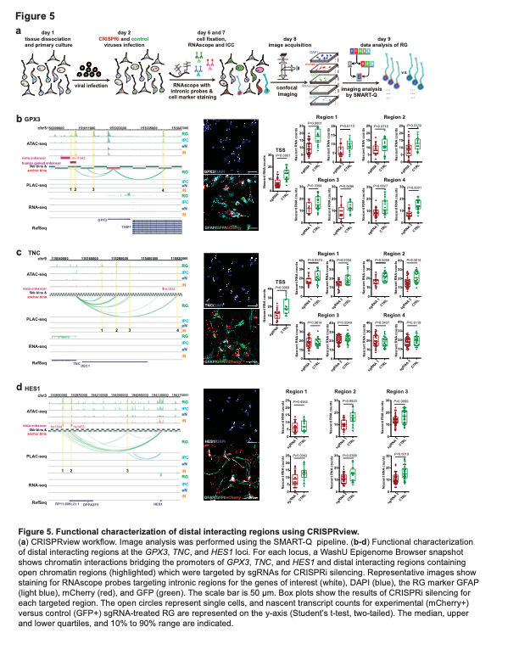
CRISPRview Design
Cell-Type Specific Enhancer
MGE IN
CRE
Gene A
CRE
Gene B
Targeting Vector
Control Vector
FISH Probes
Marker Genes
dCas9-KRAB
GFP
dCas9-KRAB
RFP
Non-targeting
CRE

Slide 150
CRISPRview Workflow
Cell-Type Specific Enhancer
Day 1
Day 2
LGE
MGE
2nd and 3rd Trimester Ganglionic Eminence
Fresh Tissues
Tissue Dissociation and primary culture
Lentiviral Transfection with Targeting and Control Vectors
Day 7
FISH Probes
DAPI and Antibody Staining

Slide 151
CRISPRview Workflow
Cell-Type Specific Enhancer
Confocal Microscopy
Image Analysis
Marker Gene
Expected Results: I expect that CRISPR inhibition of disease-associated cis-regulatory elements will result in loss of activity indicated as a decrease in nascent RNA from target gene as compared to ctrl.

Slide 152
Models for CRE Interneuron Disruption in Neuropsychiatric Disease
Multiple disease-associated cis-regulatory elements linked to single gene
MGE Prog. 1
CRE
Gene A
CRE
CRE
MGE Prog. 2
Gene A
LGE Prog.
CRE
Gene A
Disease-associated cis-regulatory elements
CRE
CRE

Slide 153
CRISPRview Design
Multiple disease-associated cis-regulatory elements linked to single gene
MGE Prog. 1
CRE
Gene A
CRE
CRE
Modified Target Vector
dCas9-KRAB
dCas9-KRAB
RFP
CRE
CRE
Sg-1
Sg-1
Sg-2
Ctl
Caveat: Does not direct test causal SNPs activity
Expected Results: I expect that combinatorial inhibition of multiple disease associated cis-regulatory elements will lead to a stronger effect on target gene expression

Slide 154
Aim II Summary
Explored cell-type specific epigenomic diversity of ganglionic eminences
Discovered disease associated cis-regulatory elements
Predicted cell-type specific variant impact using deltaSVM
4. Validated function of disease-associated cis-regulatory elements in primary culture
Caveat: Need to directly study GWAS SNPs to assess causality

Slide 155
Alternative Approach: Directly Testing Causal SNPs Effect with MGE Organoids
Cas9
HDR Template
CRE
hESCs
hESCs-SNP
Pick Colony
Culture
CRE
CRE
hMGE-SNP Organoid
CRE
CRE
scRNA-seq
WT hMGE Organoid vs. hMGE-SNP Organoid

Slide 156
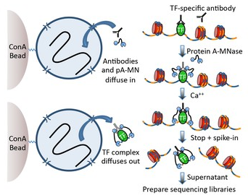
CUT&RUN

